Slide 1
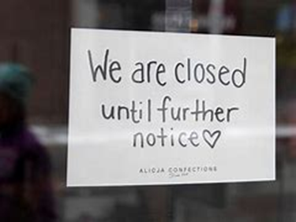
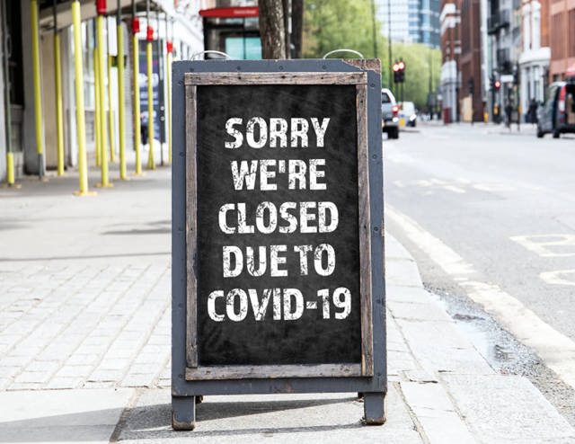



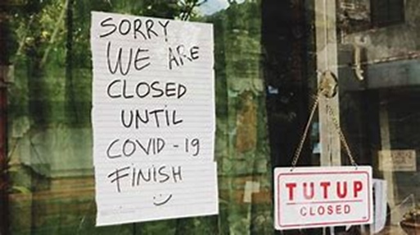
KEEPING SMALL BUSINESSES AFLOAT:
AN ANALYSIS OF THE PAYCHECK PROTECTION PROGRAM

Slide 2
AGENDA
Overview ControversyOObjective Methods Analysis Conclusion Next Steps

Slide 3
PAYCHECK PROTECTION PROGRAM
Loan program to help small businesses keep operating and maintain their workforce employed during the COVID-19 crisis.
$953 billion
No collateral
No fees
Low-interest loans (1%)
Designed to be forgiven if the funds were used for eligible expenses and the borrower met certain requirements

Slide 4
Members of Congress or spouses Billionaires Kanye West, company Yeezy > $2M 440 public companies were approved for a total of $1.39 B Total: 1.4 M loans for $64.2 B
CONTROVERSY

Slide 5
Examine the impact of the Paycheck Protection Program on vulnerable businesses, specifically businesses with less than 50 employees and businesses located in underserved areas.
OBJECTIVE

Slide 6
DATA data.sba.gov
census.gov
TOOLS Python: Cleaning and Transformation Tableau: Visualizations

Slide 7



11,460,472
$789,663,806,507
Number of Loans
Total Amount
$10 Million
$157,271
Maximum Loan Amount
Median Loan Amount

Slide 8
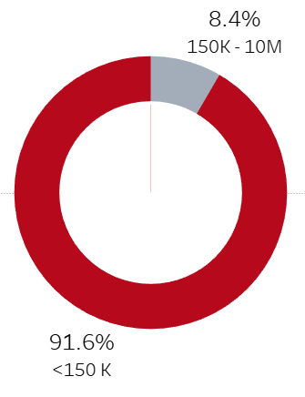


Proportion of Loans by Size
Proportion of Loans by Size & Year
Loans < $150K “Small”
Total Amount $278,424,351,229
Loans $150K - $10M “Big”
Total Amount $511,239,455,278

Slide 9
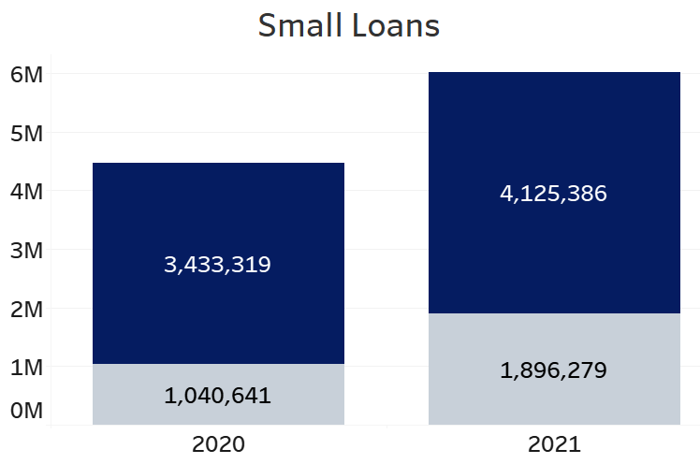
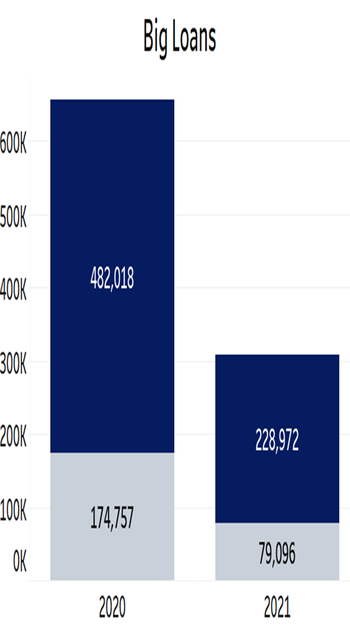
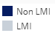
Number of Loans for Low to Moderate-Income Businesses
2020 vs 2021
Income below 80% median income

Slide 10
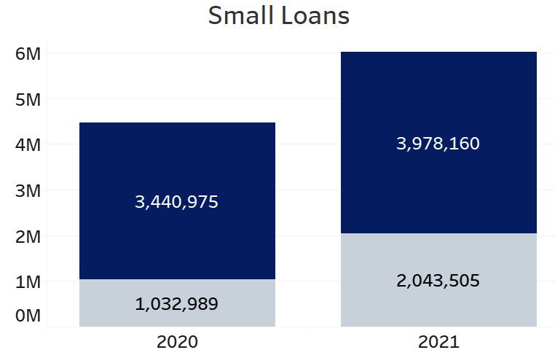
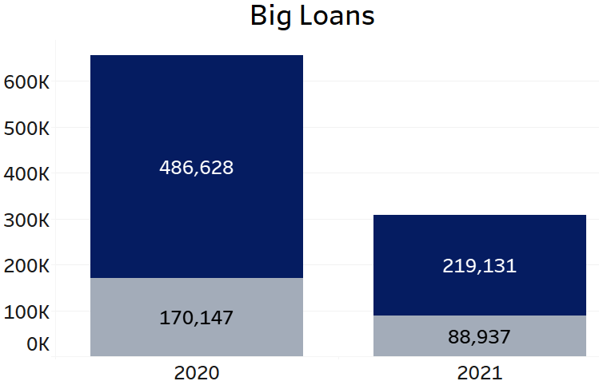

Number of Loans for Businesses in HUB Zone
2020 vs 2021
Historically Underrepresented Business Zone: to promote economic development

Slide 11
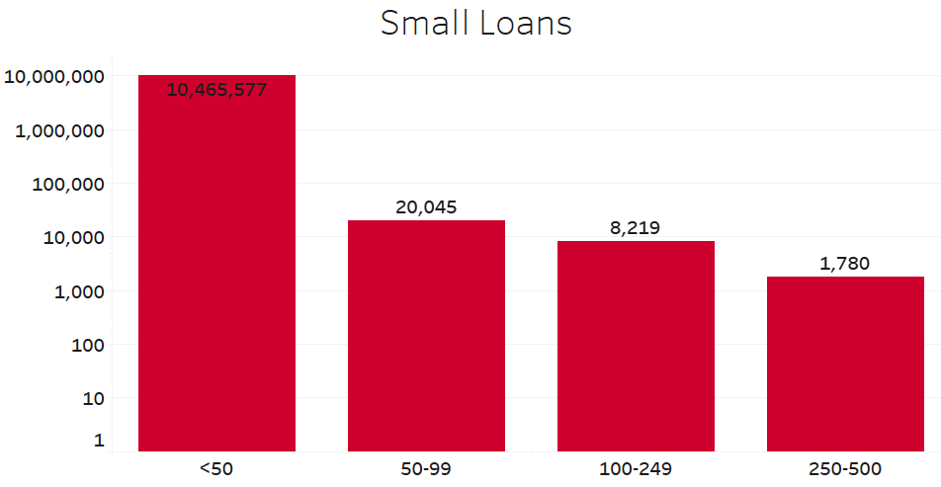
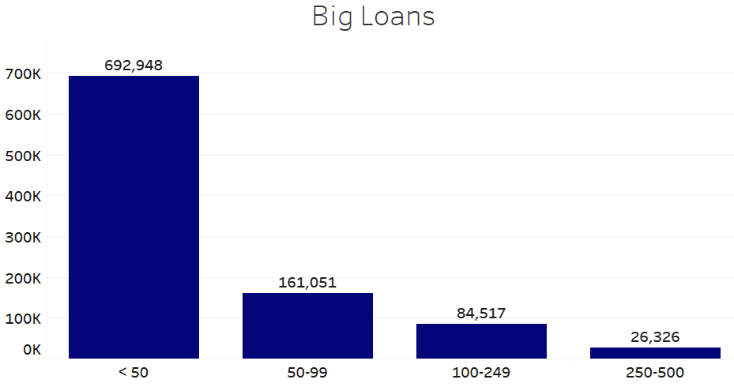
Distribution of Loans by Business Size

Slide 12
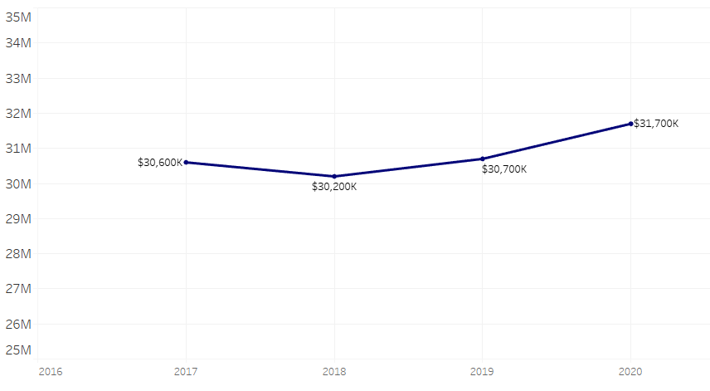
Total Number of Businesses Pre to Post
Pandemic

Slide 13
The program provided financial relief to over 11 million businesses across the US. While larger loans had a good reach among small businesses at 77%, small loans outperformed significantly with a reach of 99.7% Although small loans had a lower reach in hub zones (23%), when comparing 2020 to 2021 there was an 11% increase, from 23% to 34%. For large loans, the reach in hub zones was 26%, with a more modest 3% increase in reach from 2020 to 2021. For LMI businesses, small loans had a 23% reach, when comparing 2020 to 2021 there was an 8% increase, from 23% to 27%. For large loans, the reach in LMI businesses was 27%, with a 1% decrease in reach from 2020 to 2021. Furthermore, the total number of businesses increased post-pandemic, indicating that the aid received possibly helped prevent a more severe crisis.
CONCLUSION

Slide 14
Conduct a deeper analysis of loan distribution among minority-owned businesses based on factors such as race, gender, and veteran status. Additionally, evaluating whether capping the loan amount would make the program more effective.
NEXT STEPS

Slide 15

Diana Ospina
https://www.linkedin.com/in/ospinadiana
https://public.tableau.com/app/profile/diana.
ospina/viz/PPP2_16830633847430/Dashboard
InGeneral

Slide 16
SPECIAL THANKS

